Slide 1

ETL vs ELT in Big Data
Atif Tausif, Tausif Tusar, Raian Pial, Sushanta Sapkota, Mahdi Mahin

Slide 2
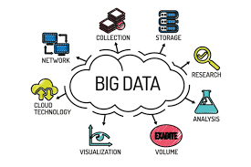
Big Data
Big Data
Extremely large datasets generated from many sources like social media,sensors, and transactions
Requires scalable systems to store and process data
Data Pipeline
A system that moves data from multiple sources to storage or analysis systems.
2 Common pipelines
ETL
ELT
Notes:
So what is big data, elt and etl. Well Big data is simply huge, complex collections of information that are too big and fast for regular tools to handle, coming from sources like social media, sensors, and transactions and they require systems to store and process data. We call these systems data pipelines in which information can be moved and processed efficiently to be used for storage or analysis of valuable insights for a company or organization. Now two of the most common data pipeline methods used in big data are ETL and ELT

Slide 3



ETL: Extract, Transform, Load
ELT: Extract, Load, Transform
Extract
Extract
Data collected from databases, APIs, and files
Data collected from databases, APIs, and files
Transform
Load
Data cleaned, filtered, formatted, and aggregated
Raw data loaded directly into data lake or cloud storage
Load
Transform
Processed data stored in data warehouse
Data transformed inside the platform using powerful computing tools
Key idea: Data is transformed before storage, ensuring clean structured data with strong quality control.
Key idea: Data is transformed after storage, enabling faster ingestion of massive datasets.
Notes:
Next, two of the most common data pipeline methods used in big data are ETL and ELT.
ETL, which stands for Extract, Transform, Load, is a traditional data processing approach.
In this process, data is first extracted from various sources, then transformed or cleaned to make it usable, and finally loaded into a storage system such as a data warehouse. The key idea is that the data is processed before it is stored.
On the other hand, ELT, which stands for Extract, Load, Transform, follows a slightly different approach. In this method, data is first extracted and immediately loaded into a storage system such as a data lake, and the transformations are performed afterward using powerful computing tools such as spark snowflake, hadoop, . This approach works better for big data because modern systems can process large datasets more efficiently after they are stored.

Slide 4
Data Pipelines
Early Data Processing (1960s–1980s)
Data Warehousing and the Rise of ETL (1990s)
Big Data and Distributed Storage (2000s)
Emergence of ELT and Data Lakes (2010s)
Real-Time Streaming Data Pipelines (Late 2010s–Present)
History and Evolution of
Originally, companies kept data in traditional transactional databases for operating. If you wanted to run analytics you had to manually export your data and do big batch processes, which were extremely slow and cumbersome.
To help create a system to analyze the data, central data warehouses were created to centralize business intelligence, and ETL pipelines were set up to extract data from multiple systems and transform it into a common format, allowing it to be loaded into the warehouse.
As storage costs drop and distributed processing systems like Apache Spark have become more powerful, organizations are now loading raw data 1st and transforming data in their large-scale data systems.
Today modern software applications continuously generate streaming data, for which companies use streaming data platforms, such as Apache Kafka, to ingest real-time data and run analytics in their modern big data architecture.
As the internet has grown and there have been more distributed data systems like Apache Hadoop, the amount of data that organizations can store has skyrocketed.

Slide 5



Kafka
Modern Big Data Tools
Spark
Hadoop
Kafka is used for real-time data feeds, streaming large amounts of data from multiple sources to Spark for processing or Hadoop for storage.
Spark is a distributed processing engine used to analyze large datasets and perform ELT transformations, often by reading data streams from Kafka and processing data stored in Hadoop.
Hadoop provides distributed storage for massive datasets and can store raw data accessed by Spark for processing or ingested from Kafka streams.

Slide 6
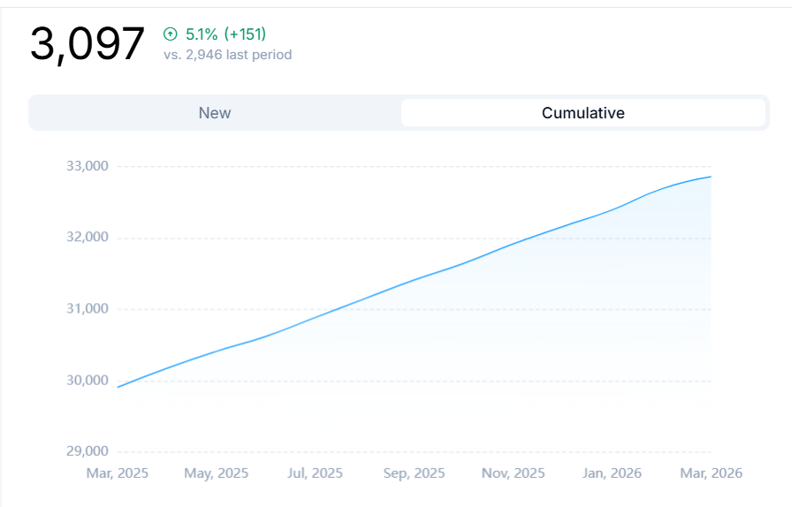
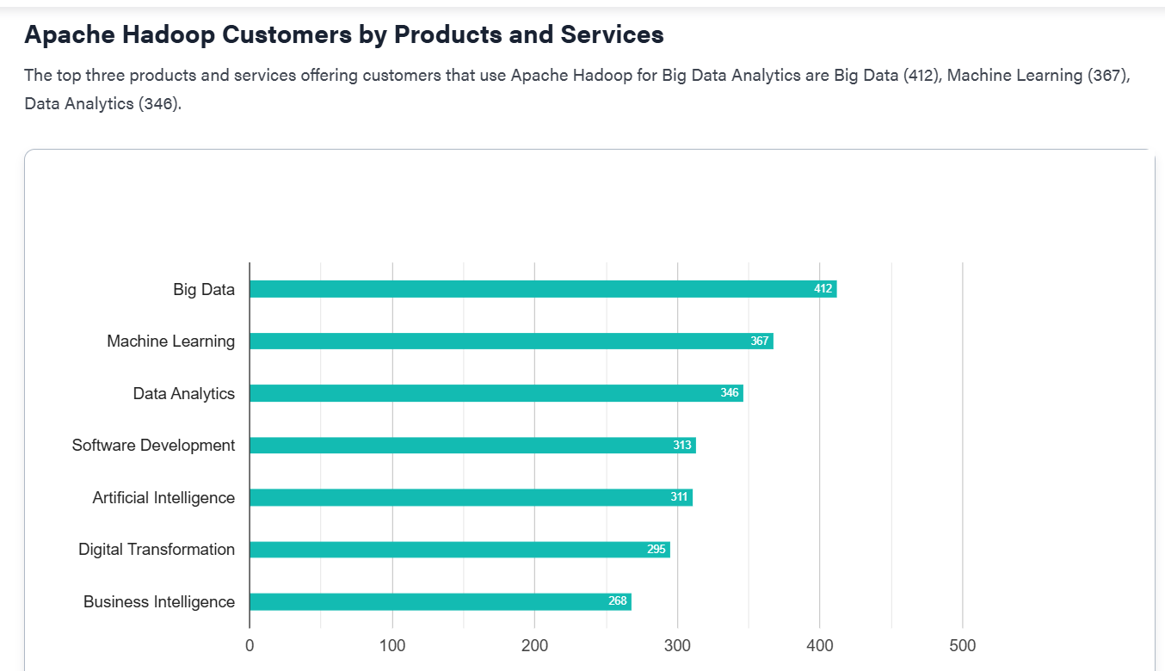
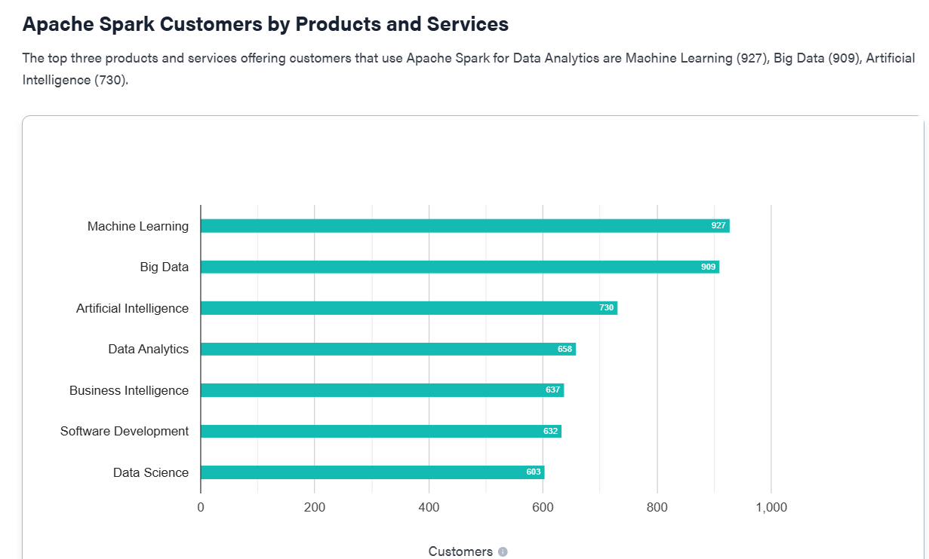
Kafka
Spark
Hadoop
Popularity and Community Support
Kafka is extremely popular, used by over 80% of the Fortune 100 companies and nearly 50,000 organizations worldwide. It is one of the five most active projects in the Apache Software Foundation and has over 5 million unique lifetime downloads.
Spark is one of the most widely adopted and popular big data processing frameworks globally, with a large and active open-source community. It has become the largest open-source community in big data, with over 1,000 contributors from more than 250 organizations, and is used by major enterprises across diverse industries.
Hadoop is used in large enterprises and organizations with legacy on-premise infrastructure. As of 2026, Apache Hadoop holds 8.71% market share in the big-data-analytics category, competing with tools like Databricks (17.53%), Azure Databricks (16.76%), and Microsoft Azure Synapse (9.58%). Over 8,498 companies worldwide use Hadoop

Slide 7
Spark
Kafka
Hadoop

Slide 8
ETL vs ELT Side-by-Side Comparison
Feature
ETL Extract → Transform → Load
ELT Extract → Load → Transform
Transformation
Before loading
Inside data warehouse/lake
Speed
Slower for large datasets
Faster with modern engines
Data Storage
Only processed data
Briefly describe the content of this asset.
Big Data Tools
Spark ETL pipelines
Kafka + Spark + Hadoop
Best For
Structured warehouses
Data lakes & streaming
Scalability
Limited
Highly scalable
Notes:
ETL (Extract, Transform, Load) is the traditional approach where data is cleaned and structured in a separate staging area before it ever reaches the target database. This method is ideal for structured data warehouses and environments with strict security requirements, as it ensures that only "clean" data is stored. However, because the transformation happens on an external server, it can create a significant bottleneck when handling massive datasets, often resulting in slower processing speeds compared to modern alternatives.
In contrast, ELT (Extract, Load, Transform) leverages the power of modern cloud data warehouses and lakes by loading raw data directly into the target system first and performing transformations afterward. This "load-first" strategy is highly scalable and significantly faster for big data and streaming services since it utilizes the parallel processing power of the warehouse itself. ELT is particularly flexible for your future data needs because it preserves the original raw data, allowing you to re-transform it as your analysis requirements evolve over time.

Slide 9
ETL — Pros & Cons
Pros
Cons
Cleaner data before storage
Less storage usage — only processed data kept
Slower processing with very large datasets
Not ideal for streaming pipelines
Strong data governance and compliance
Less flexible when new transforms needed

Slide 10
ELT — Pros & Cons
Pros
Cons
Faster ingestion of large data volumes
Supports real-time analytics
Requires powerful storage & compute systems
Raw data storage increases costs
More flexible transformations on demand
Security and governance can be harder

Slide 11

Industry Relevance
Use-cases for ETL
Banks — regulators need exact numbers, can't report messy data
Healthcare — HIPAA requires sensitive patient data to be cleaned and masked before storage
Insurance — claims, fraud detection, and actuarial work all need precise, pre-formatted data
Government agencies — strict audit trails, everything has to be accounted for
ETL for reliability & governance
Architecture

Slide 12
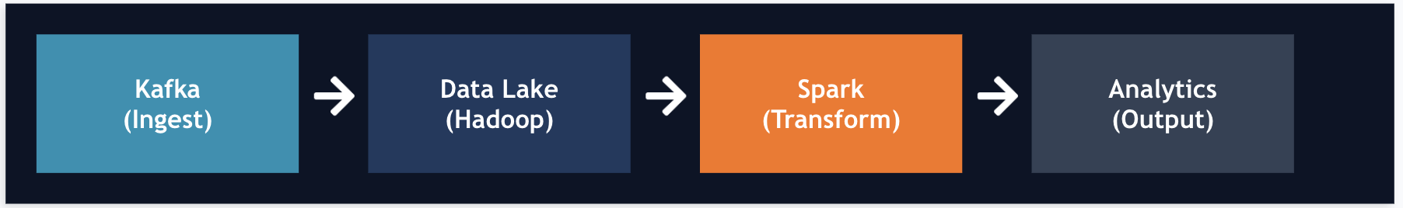
Industry Relevance
Use-cases for ELT
Tech companies — too much user data to clean upfront. Store it raw, figure out what you need from it later.
ML/AI teams — they want raw data in bulk. How they shape it depends on whatever model they're training.
Data lake shops (Snowflake, Databricks, BigQuery) — the lake exists so you can store raw and transform when you're ready.
Ride-sharing and delivery apps (Uber, DoorDash) — GPS pings, trip data, surge pricing all happen in real time. They dump everything into a lake and run analytics on it after to optimize routes and pricing.
ELT for scalability & real-time processing
Architecture

Slide 13
Recommendations & Conclusion
ETL is suited for structured, controlled environments with strict governance
ELT is better for modern big data and streaming systems at scale
Use ELT with Kafka, Spark, and Hadoop for scalable big data analytics and real-time processing
ETL remains valuable for traditional enterprise data warehouses where governance and data quality are the top priority

Slide 14
Thank You!
Q&A

